Slide 1
GANalyze: Toward Visual Definitions of Cognitive Image Properties
Goetschalckx Lore, Andonian Alex Oliva, Aude and Isola Phillip.
GANalyze: Toward Visual Definitions of Cognitive Image Properties. International Conference on Computer Vision(ICCV), 2019: 5744-5753.

Slide 2
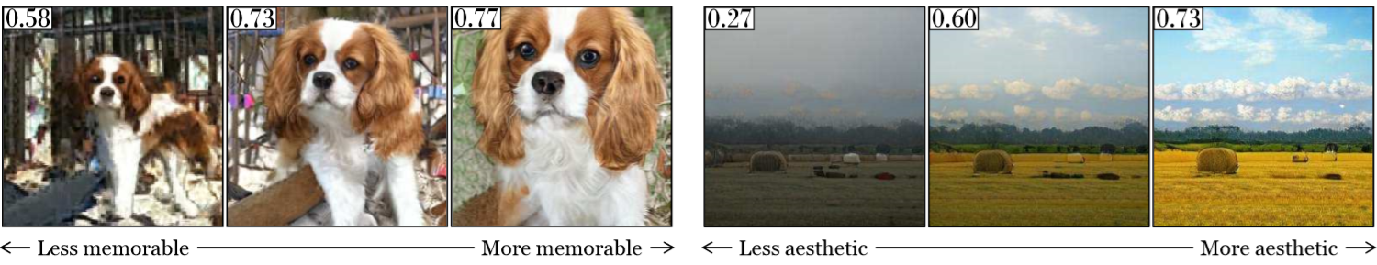
1. GANalyze
GANalyze introduces a framework that uses Generative Adversarial Networks (GANs) to study cognitive properties like memorability, aesthetics, and emotional valence. GANalyze makes the model generates more impressive images by adjusting latent code z.

Slide 3
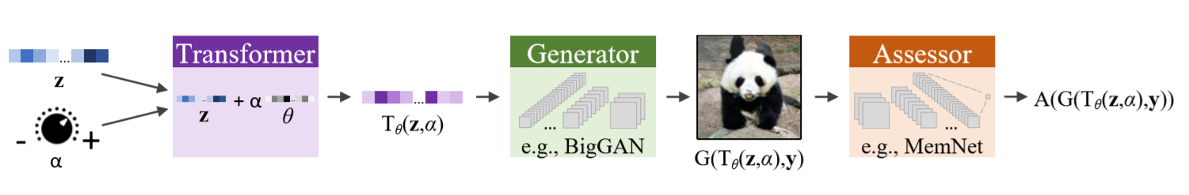
2. Model Framework

Slide 4
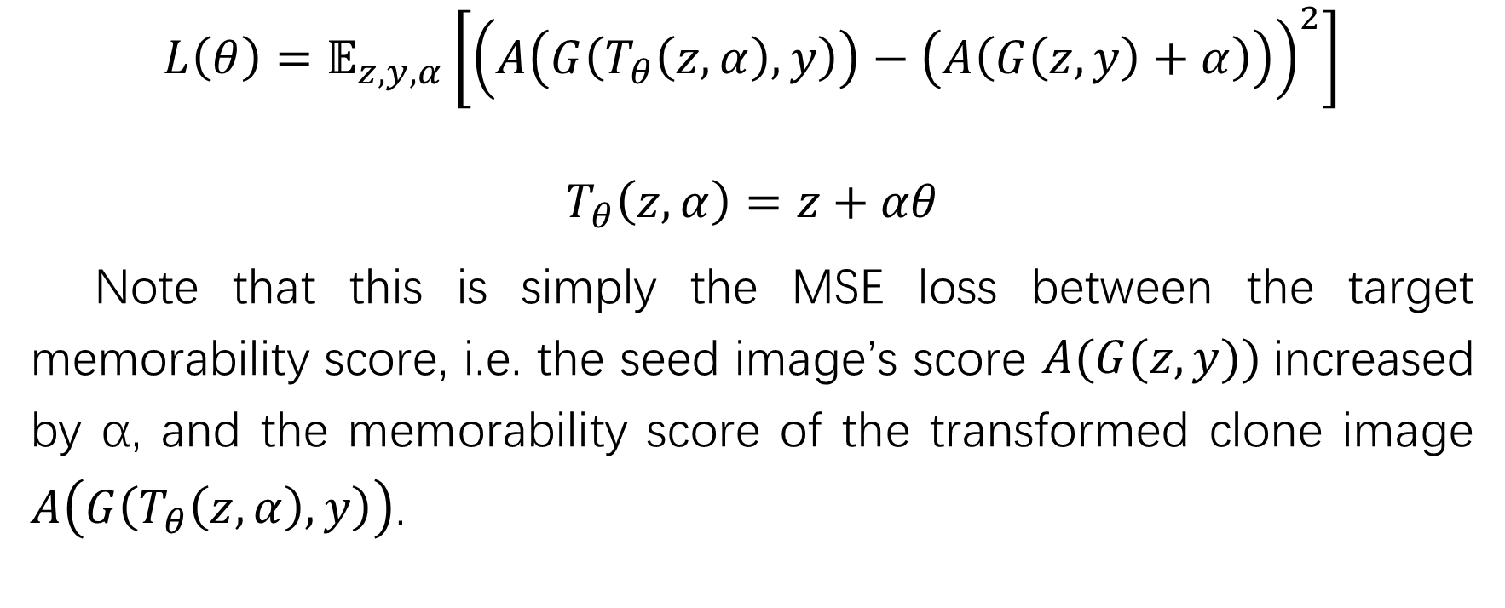
3. Loss Function
$$L\left(θ\right)=𝔼_{z,y,α}\left[{\left(A\left(G\left(T_{θ}\left(z,α\right),y\right)\right)−\left(A\left(G\left(z,y\right)+α\right)\right)\right)}^{2}\right]$$
$$T_{θ}\left(z,α\right)=z+αθ$$
Note that this is simply the MSE loss between the target memorability score, i.e. the seed image’s score $A(G(z,y))$increased by α, and the memorability score of the transformed clone image $A\left(G\left(T_{θ}\left(z,α\right),y\right)\right)$.

Slide 5
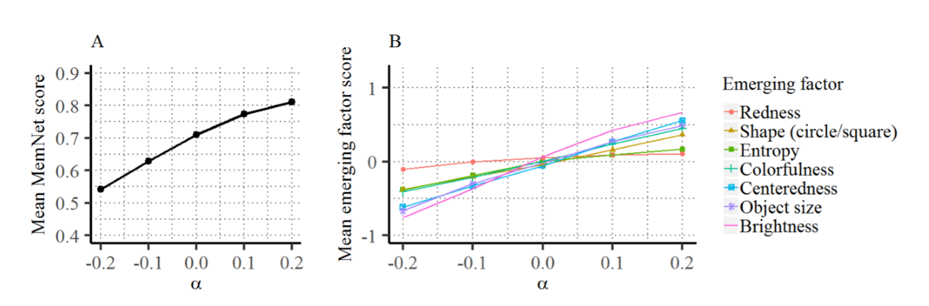
4. Experiments
(A) shows the mean MemNet score across the images in every α condition. (B) shows emerging factors potentially underlying the effect observed in (A), and graph of how they change in function of α.

Slide 6
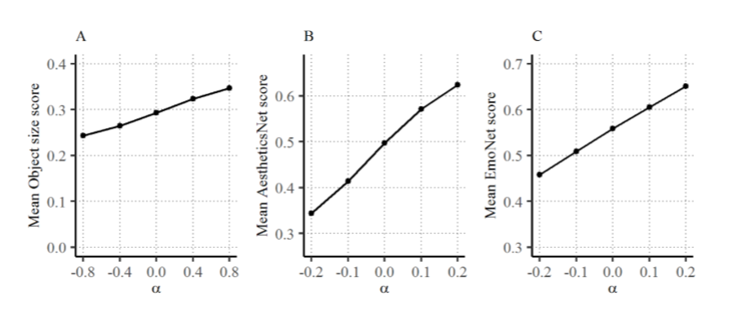
4. Experiments

Slide 7
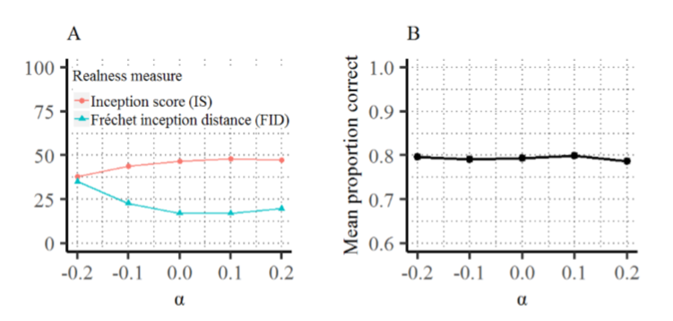
4. Experiments
(A) Two popular automatic measures for evaluating the realness of a set of GAN images. Note that lower FID values indicate higher realness. (B) Human fakeness discriminability.

Slide 8
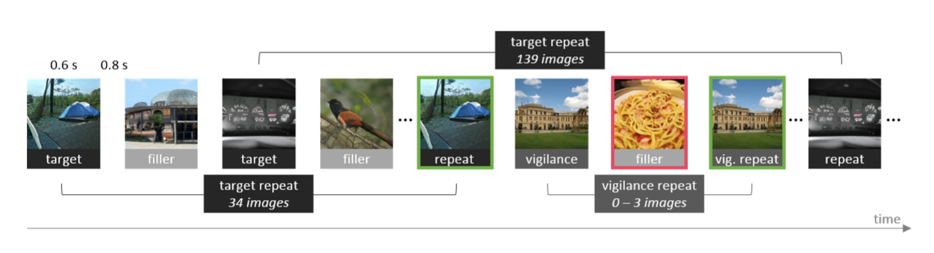
4. Experiments

Slide 9
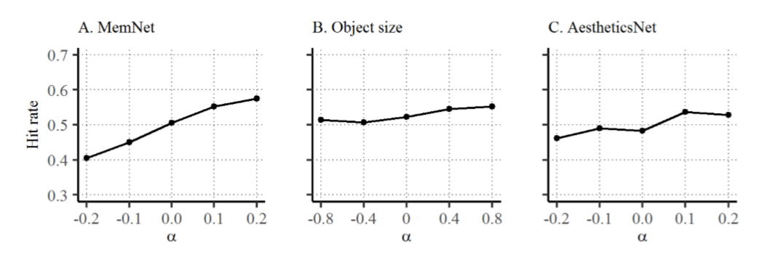
4. Experiments
These three graphs show the probability that a person can recognize two identical images under different alpha values

Slide 10
5. Inspiration
For less innovative work, we can verify the effectiveness of the algorithm by conducting experiments in more models.

Slide 11
Thanks for listening!

